Slide 1







How Can Feature Selection Techniques Improve Software Quality Prediction?
Presented and designed by: Mohammadali (Mo) Rahnama
v

Slide 2

AGENDA
AGENDA
What is Software Quality Prediction?
What is Feature Selection?
Which Techniques Can We Use?
Is It Worth It?
Let’s Review

Slide 3



What is Software Quality Prediction?
Not Again!
Notes:
Software is used in almost every part of life today, including healthcare, industry, vehicles, and so on.
So, it is very important that the software always works the way it is supposed to. This can only happen if the software is free of bugs.
Software testing is always needed for high-quality software products.
In the past, manual testing was used to check the quality of software, but this is a very complicated process that takes a lot of time and work.
So, software fault prediction is used to find modules that are likely to fail before they do.
It makes it easier for the testing team to focus on only the bad modules.
This will save testing time, money, and effort, all of which are in short supply.

Slide 4

How Can We Predict Software Quality?
I see a bug in your future!
Notes:
During the software development life cycle (SDLC), the internal quality of a piece of software can be measured. The external quality, on the other hand, can be measured during its implementation and judged based on how well it works.
The way it looks on the outside also depends on how it looks on the inside.
Quality models that are based on the internal quality attributes can be made to measure the external quality of a software product.
To do this, first you have to figure out what the internal qualities are, and then you have to figure out what the relationship is between the internal and external qualities.
Several authors have come up with models for predicting the quality of software.
But machine learning seems to be a more popular and effective way to come up with such a model, as the authors claim.

Slide 5
What is Feature Selection?
Robbie, Stop misbehaving, or I will send you to Back to data cleaning!
Notes:
In machine learning, a "feature" is a property that can be measured on its own.
The way our machine learning model works can be affected by data features that are not relevant or that give the wrong impression.
So, when making a model, the first step should be to clean up the data.
Feature selection methods narrow down the number of input variables or features to only those that are thought to help predict the target.
So, the main goal of feature selection is to get rid of predictors that aren't useful or are used more than once in our machine learning model.

Slide 6

Why Should We Use Feature Selection?
Processing TIME
25 Days …
Notes:
Here are some reasons why it's a good idea to choose features before modelling starts:
Less model overfitting: Less redundant data means fewer chances to make decisions based on noise.
Accuracy Improvement: Less misleading and wrong data means that modelling accuracy will improve.
Less time spent training: Less data means that algorithms can learn faster.

Slide 7
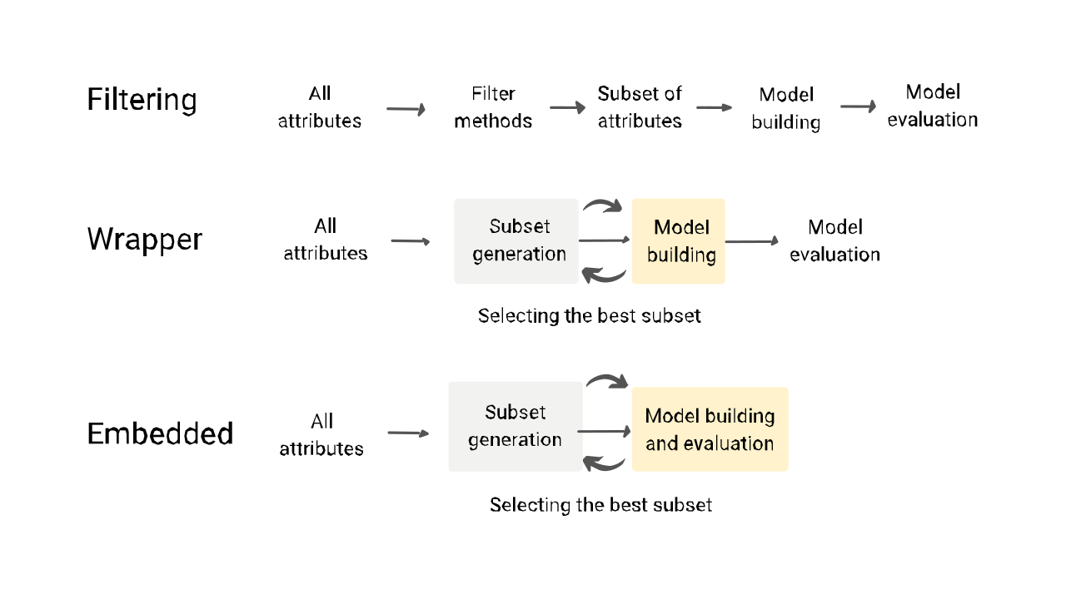
Which Techniques Can We Use to Predict Software Quality?
Notes:
Filter Method: In this method, features are dropped based on how they relate to the output, or how they are correlating to the output.
We use correlation to see if the features are related to the output labels in a positive or negative way. If they are, we drop those features.
For example: Information Gain, Chi-Square Test, Fisher’s Score, etc.
Wrapper Method: We divide our data into smaller sets and use these to train a model.
Depending on what the model comes up with, we add or remove features and train the model again.
It uses a greedy method to make the subsets and checks the accuracy of all possible combinations of features.
For example, Forward Selection, Backwards Elimination, etc.
Embedded Method: This method combines the best parts of both the Filter and Wrapper methods to make the best subset.
This method takes care of the iterative process of teaching a machine while keeping the cost of computation as low as possible.
Lasso and Ridge Regression are examples.

Slide 8
Which Techniques Can We Use to Predict Software Quality?
Notes:
A systematic review of the literature was done, and 15 studies from 2007 to 2017 were chosen to answer the following research questions.
These Research question are meant to help us understand the range of feature selection techniques that are being used, as well as their effectiveness and applicability:
Question1) What kinds of techniques for choosing features have been suggested to predict the quality of software? The figure shows how the feature selection types are spread out
It was clear that most of the chosen primary studies (60%) used the filter method, while only a small number of studies (20%) used the wrapper and ensemble methods.
The ensemble method has been shown to be very effective, and in three studies, it has done better than other feature selection methods.

Slide 9
Notes:
Question 2: What are the specific techniques for selecting features that are used to predict software quality?
This graph shows the most common method for choosing features used by some primary studies
RELIEF is the feature selection method that has been used by six studies the most.
It's important to note that all of these techniques, except for the support vector machine, fall under the filter method.
Here is a short explanation of the three most common methods:
Relief
Relief looks at each attribute and figures out its score by sampling over and over again.
In the Relief algorithm, the score is based on the difference between the values of the attributes of the two closest neighbours.
Symmetrical uncertainty By figuring out the symmetrical uncertainty, which deals with the problem of information gain bias, symmetrical uncertainty chooses attributes.
This problem is about attributes with more than one value, which are normalized from 0 to 1.
Gain ratio
Gain ratio uses a decision tree that looks at the number and size of the branches to choose which attributes to use.
The gain ratio is a newer version of the information gain that makes it less biased with respect to the information that is already in the system during splitting.

Slide 10
Is It Worth It?
Embedded method had the best prediction accuracy among the other feature selection methods.
Notes:
RQ2) What is the impact of the feature selection techniques on prediction accuracy?
To answer RQ2, all
the feature selection techniques used by selected primary studies improved the prediction accuracy over using all features (i.e. without applying feature selection) and the ensemble methods produced a better prediction accuracy compared to single feature selection

Slide 11

Let’s Review
Testing is how we check the quality of software, but it takes a lot of time and work.
By predicting when fault-prone modules will happen, we save testing resources like time, effort, and money.
The most popular and accurate models for predicting software quality use machine learning techniques.
All feature selection methods result in more accurate predictions.
1
2
Perfect!
2
2
3
4
Notes:
Testing is how we check the quality of software, but it takes a lot of time and work.
By predicting when fault-prone modules will happen, we save testing resources like time, effort, and money.
The most popular and accurate models for predicting software quality use machine learning techniques.
All feature selection methods result in more accurate predictions.

Slide 12
Thank You!

Slide 13
References
S. Shafi, S. M. Hassan, A. Arshaq, M. J. Khan, and S. Shamail, “Software quality prediction techniques: A comparative analysis,” in 2008 4th International Conference on Emerging Technologies, 2008, pp. 242–246. doi: 10.1109/ICET.2008.4777508.
​S. Bouktif, F. Ahmed, I. Khalil, and G. Antoniol, “A novel composite model approach to improve software quality prediction,” Inf Softw Technol, vol. 52, no. 12, pp. 1298–1311, 2010, doi: https://doi.org/10.1016/j.infsof.2010.07.003.
Z. Xu, J. Liu, Z. Yang, G. An, and X. Jia, “The Impact of Feature Selection on Defect Prediction Performance: An Empirical Comparison,” in 2016 IEEE 27th International Symposium on Software Reliability Engineering (ISSRE), 2016, pp. 309–320. doi: 10.1109/ISSRE.2016.13.
H. Alsolai and M. Roper, “A systematic review of feature selection techniques in software quality prediction,” in 2019 International Conference on Electrical and Computing Technologies and Applications (ICECTA), 2019, pp. 1–5.
2
2

